Slide 1

Rain Prediction in Australia
-Group 5
Mentored by:
Mr.Vikash Chandra
Presented by:
T Balaji
K B Charles
D Harun Raj
S Melvin
B Nitin Somasundar
Pranav Hari

Slide 2
Problem Statement
In recent years, Australia has experienced numerous floods, storms and bushfires that have had a devastating effect on its properties, businesses and lives.
Many organizations are already finding it increasingly difficult to respond proactively to these unpredictable disasters.
Major natural catastrophes are a heavy burden even to successful economies like Australia.
As the climate continues to change, the frequency and severity of these extreme weather conditions is likely to increase as well.

Slide 3
Problem Statement
Floods, in particular the flash floods are common in Australia, can happen anywhere, also in extremely dry regions.
On the other hand, lack of rainfall has severely affected the agricultural industry, which is one of the major contributors to Australia’s economy.
Dry conditions and lack of rainfall are the major cause for the infamous bushfires.
The drought and low rainfall have been a major issue not only in Australia but across the globe.

Slide 4
Need For the Study
Data from previous years suggests that 97% of disaster funding is spent on post-disaster relief and recovery, with only 3% invested in mitigating a disaster before it happens.
Despite regular loss events, the consequences of flooding are still often underestimated both in Australia and around the world.
It is important to exactly determine rainfall for the effective use of water resources, crop productivity and preplanning of water structures.

Slide 5
Need For the Study
It is also necessary for organizations and even individuals to know beforehand to plan accordingly.
Hence, predicting rainfall in the forthcoming years is vital, as it not only allows world governments to formulate policies accordingly in many fields but also helps in taking precautionary measures.

Slide 6
Objective
To propose a classification model that can predict whether it will rain tomorrow in Australia.
To analyze based on the humidity, temperature, evaporation, sunshine, wind direction & speed, wind gust direction & speed.

Slide 7
Description of the Data
Given below are the features of the dataset,
Date : Denotes the particular date, month, year in Australia
Location : Denotes the specific city in Australia
MinTemp : The lowest temperature in the city
MaxTemp : The highest temperature in the city
Rainfall : The amount of rainfall in particular date and location
Evaporation: The amount of evaporation in particular date and location
Sunshine : The amount of sunshine in particular date and location
WindGustDir : The direction of the wind gust
WindGustSpeed : The speed of the wind gust
WindDir9am : The wind direction at 9AM
WindDir3pm : The wind direction at 3PM

Slide 8
Description of the data
WindSpeed9am : The wind speed at 9 AM
WindSpeed3pm : The wind speed at 3 PM
Humidity9am : The percentage of water vapor content in the air at 9AM
Humidity3pm : The percentage of water vapor content in the air at 3PM
Pressure9am : The atmospheric pressure at 9AM
Pressure3pm : The atmospheric pressure at 3PM
Cloud9am : The amount of cloud cover measured in oktas at 9AM
Cloud3pm : The amount of cloud cover measured in oktas at 3PM
Temp9am : The temperature at 9 AM
Temp3pm : The temperature at 3PM
RainToday : Whether it will rain today YES/NO

Slide 9
Description of the data
Target Variable:
RainTomorrow (Y) : Whether it will rain tomorrow YES/NO
Data Information:
Total number of rows: 145460
Total number of columns: 23
(6 Categorical features, 16 Numerical features, 1 target variable)

Slide 10
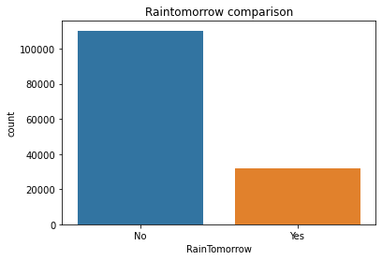
Exploratory Data Analysis
Relationship between the variables:
Rain Tomorrow:
It can be seen that there is 77.5% chance of not raining and 22.5% of raining the following day.

Slide 11

Rain Today:
It can be seen that there is 77.5% chance of not raining and 22.5% of raining the present day.

Slide 12
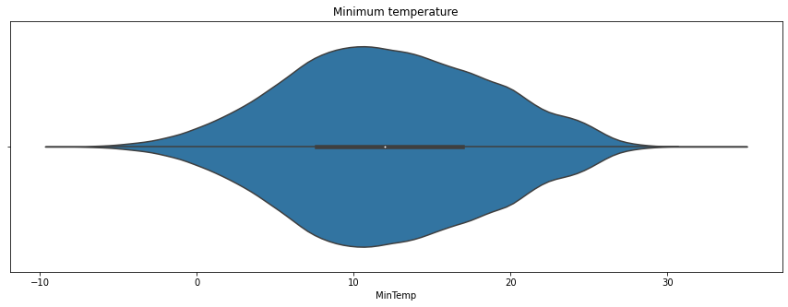
Minimum Temperature:
Minimum temperature seems normally distributed and outliers present on the variable and lies between 8 to 18 mean and 50th percentile are equal therefore the minimum temperature variable is normally distributed.

Slide 13
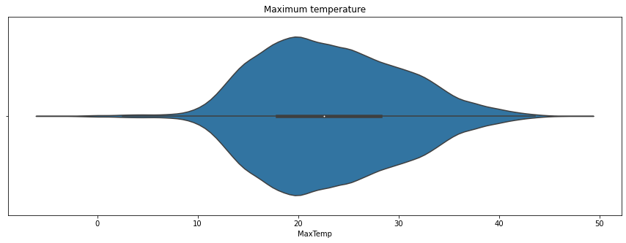
Maximum Temperature:
Maximum temperature seems normally distributed and outliers present on the variable and lies between 18 to 28 mean and 50th percentile are equal, hence maximum temperature is also normally distributed.

Slide 14
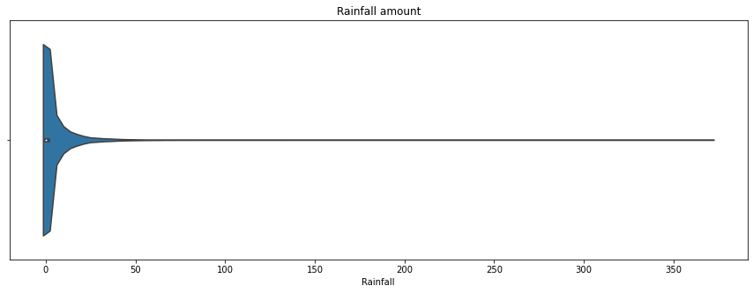
Rainfall Amount:
Total rainfall falls between the range from 0 to 1 percent from the overall values.

Slide 15
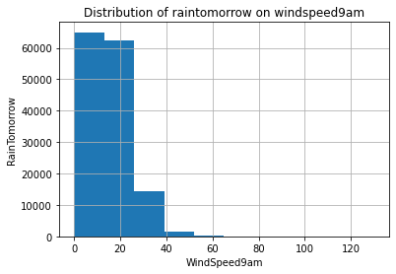
Rain Tomorrow vs Wind Speed 9am :
It can be seen that the wind speeds at 9 am were lower than 50 units. The overall rain tomorrow falls between 0 to 24 km/hr wind speed.

Slide 16
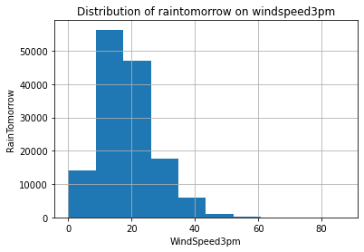
Rain Tomorrow vs Wind Speed 3pm :
It can be seen that the wind speeds at 3 pm are lower than 50 units. The overall rain tomorrow falls between 15 to 35 km/hr wind speed.

Slide 17
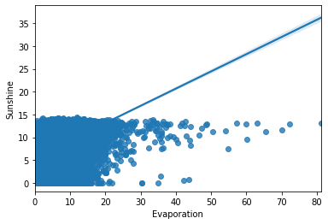
Sunshine vs Evaporation:
It is clearly seen that when sunshine increases the evaporation also increases.
Major sunshine and evaporation points falls on 0 to 15, while the sunshine and evaporation ranges between 0 to 35.

Slide 18
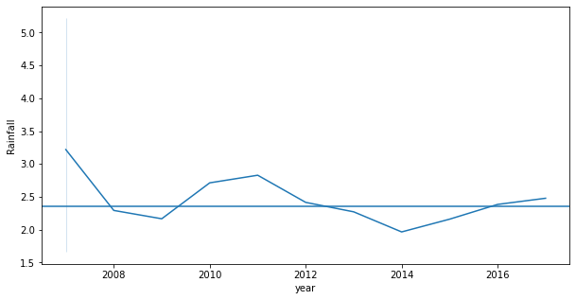
Rainfall vs Year:
It can be seen that the rainfall and year have up and down relationship.
The years’ 2007 and 2011 has the highest amount of rainfall. 2014 and 2009 has the lowest amount of rainfall during these years.

Slide 19
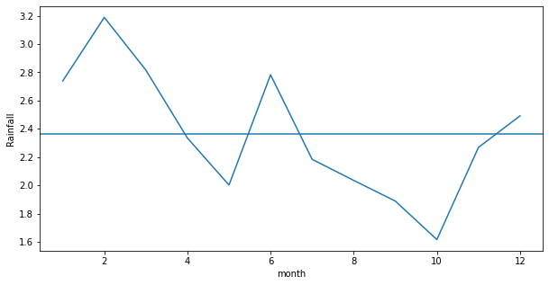
Rainfall vs Month:
It can be seen that the rainfall and month also have up and down relationship.
February and June receive maximum rainfall. May and October months receive minimum rainfall.

Slide 20
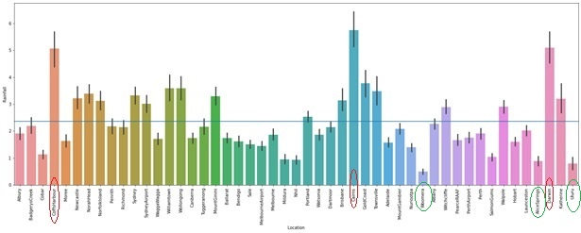
Rainfall vs Location:
The highest rainfall for the top three cities is Caims followed by Darwin and Caffsharbour, which are circled in red.
The lowest rainfall for the top three cities is Woomera followed by Uluru and Alice springs, which are circled in green.

Slide 21
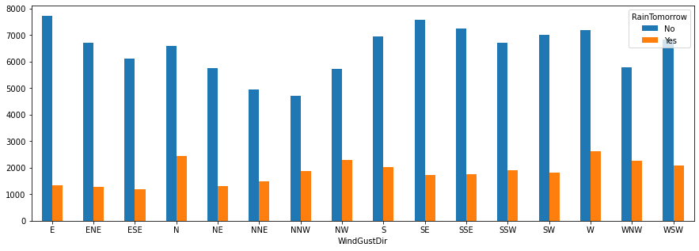
Wind gust direction vs Rain tomorrow:
If the wind gust direction is east and southeast the chance of raining tomorrow is less.
We can expect rain tomorrow if the wind gust is in west direction followed by north and north west direction.

Slide 22
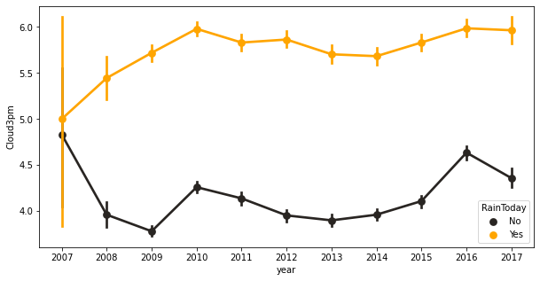
Cloud at 3pm vs Rain today:
As we can see from the above plot that if the cloud cover is more then it may rain today.
If there is less cloud cover, then there is less chance of rain today throughout out the years.

Slide 23
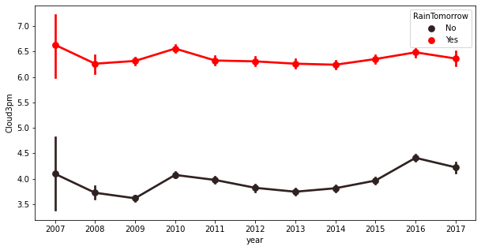
Cloud at 3pm vs Rain tomorrow:
As we can see from the above plot that if the cloud cover at 3 pm is more then it may rain tomorrow.
If there is less cloud cover, then there is less chance of rain tomorrow throughout out the years.

Slide 24
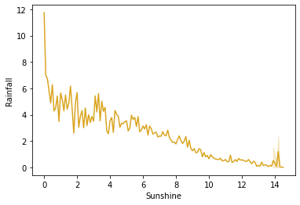
Sunshine vs Rainfall:
It can be seen that when sunshine decreases rainfall gradually increases, this clearly shows that rainfall and sunshine are inversely proportional to each other.

Slide 25
Feature Engineering:
There are some irrelevant Features which are dropped.
For example,'WindGustDir','WindDir9am','WindDir3pm’ has the unique and same value for all the records like 'W', 'WNW', 'WSW', 'NE', 'NNW', 'N', 'NNE', 'SW', 'ENE', 'SSE', 'S', 'NW', 'SE', 'ESE', 'E', 'SSW‘, hence these 3 features are dropped.
`Location’ feature has unique of 49 different names which is not used for the next model building hence this feature is dropped.

Slide 26
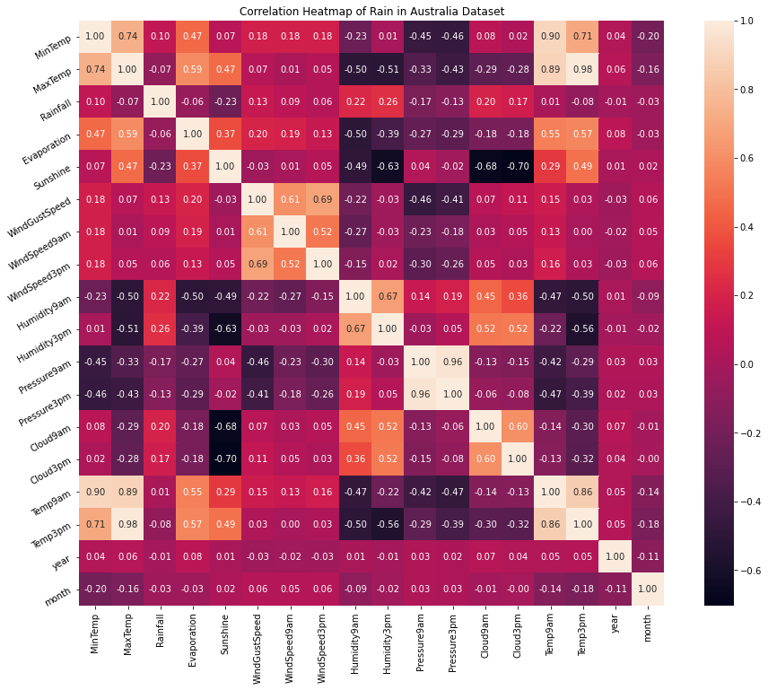
Correlation of the dataset:

Slide 27
The correlation plot tells that maximum temperature and minimum temperature are highly correlated compared to other features.
Temperature at 3pm and temperature at 9am features are also highly correlated with each other.
Pressure at 9am and pressure at 3pm are also highly correlated with each other, so they can’t contribute to model accuracy instead they are duplicate values.
Correlated with each other variables would have been remove because they can’t contribute much to the model.
Hence from the correlation heat map we can see that the minimum temperature, maximum temperature, temperature at 9am and temperature at 3pm are highly correlated with each other.

Slide 28
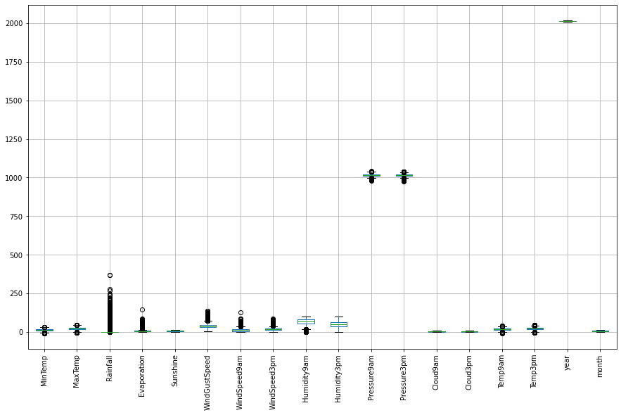
Checking of outliers:

Slide 29
The rainfall feature has a high number of outliers detected followed by wind gust speed and wind speed at 9am.
There are no outliers detected on the cloud 9am, cloud 3pm, humidity, month and year.
Future Tasks:
After Data analyzing, Cleaning, Missing values and Outliers treatment we proceed to start building the machine learning model i.e. start with base model Logistic Regression.
After Logistic Regression model is built, we would like to try several classification models such as Decision Tree, Random Forest, Naïve Bayes.
We would also like to Use hyper parameter tuning to the model to increase the model accuracy.
After all the above tasks are done we use ensemble technique to the models to select which model is gives maximum accuracy to the target variable

Slide 30
Thank you

